Slide 1

PRESENTEDBY:- P.LAKSHMI NARAYANA P.SOWJANYA M.DILLSWARI A.RAMYA P.JYOTHIKAMEHER KALYANI

Slide 2
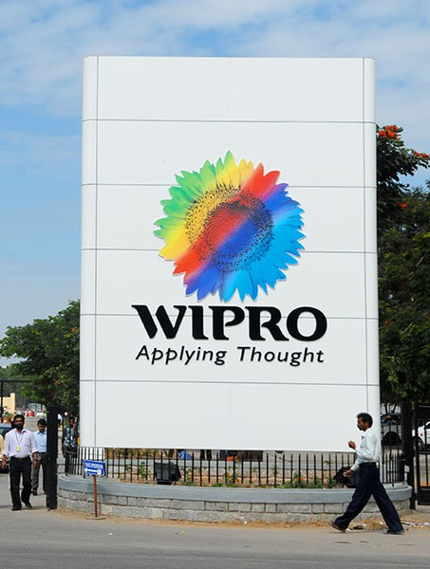
AGENDA
INTRODUCTION
ABOUT DIGITAL MARKETING
WIPRO BRAND STUDY
WIPRO COMPETITOR ANALYSIS
SEO AND KEYWORD RESEARCH
WIPRO CONTENT
WIPRO CURATION

Slide 3


INTRODUCTION
.

Slide 4
INTODUCTION FOR WIPRO IT
Wipro Limited, headquartered in Bangalore, India, is a globally renowned information technology, consulting, and business process services company with a rich history dating back to 1945 when it was founded as Western India Palm Refined Oil Limited.
Over the years, it has transformed into one of India's most prominent and diversified IT firms. Wipro operates in more than 175 cities across 67 countries, serving a diverse client base from various sectors. The company offers a comprehensive range of services, including IT consulting, application development,

Slide 5
INTODUCTION FOR WIPRO IT
infrastructure management, business process outsourcing, and digital transformation solutions.
With a strong focus on emerging technologies like artificial intelligence, cloud computing, and cyber security, Wipro is at the forefront of innovation. Its commitment to corporate social responsibility is exemplified by initiatives that support education, healthcare, and environmental sustainability, including the Azim Premji Foundation.
Wipro's diverse and talented workforce, commitment to innovation, and impressive financial performance make it a significant player in the global IT and consulting industry, reinforcing India's reputation as an IT powerhouse.

Slide 6
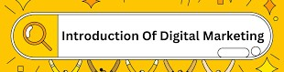
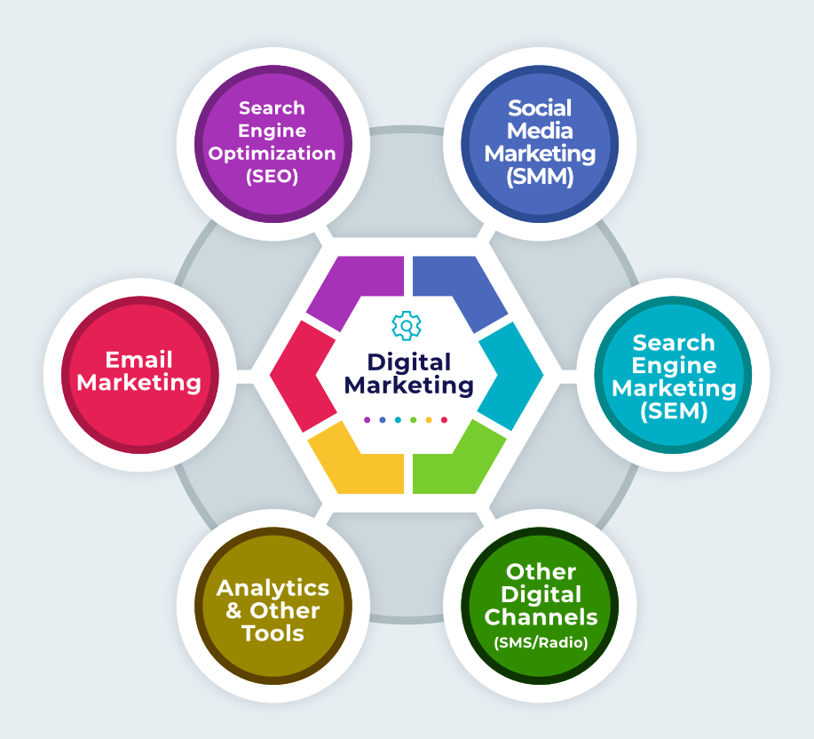
DIGITAL MARKETING INCLUDES :-
ONLINE PRESENCE
SEARCH ENGINE OPTIMIZATION
CONTENT MARKETING
SOCIAL MEDIA MARKETING
EMAIL MARKETING
PAID ADVERTISING
ANALYTICS AND DATA
CONVERSION RATE OPTIMIZATION
MOBILE MARKETING
E-COMMERCE AND ONLINE SALES

Slide 7
Mission/Values:
Wipro's mission is to be a leading global information technology company dedicated to delivering high-quality, cost-effective, and innovative solutions to clients around the world. At the core of their business operations are a set of fundamental values that guide their corporate culture. These values include integrity, emphasizing honesty and ethical behavior in all their dealings; customer centricity, focusing on understanding and exceeding client needs and expectations; innovation, which is seen as a catalyst for positive change; respect for people, fostering a diverse and inclusive work environment; excellence, striving for the highest quality in all they do; a commitment to continuous learning and development; and teamwork, emphasizing collaboration and synergy as essential to their success. These mission and values collectively shape Wipro's identity and approach to serving its clients and the broader community.
USP:
Wipro's unique selling propositions (USPs) lie in its extensive global presence, diverse service offerings, commitment to innovation, strong focus on sustainability, unwavering corporate values, client-centric approach, and a globally distributed talent pool. With a footprint in over 175 cities worldwide, Wipro has the capacity to provide a wide spectrum of IT services, ranging from software development to digital transformation, ensuring that clients' needs are met across various industries. Their emphasis on innovation, backed by research centers dedicated to emerging technologies, keeps them at the forefront of the IT industry. Furthermore, their dedication to environmental sustainability and ethical corporate practices aligns with evolving business values, making them a trusted partner for long-term, client-tailored solutions.

Slide 8
Set 5 SMART goals and KPIs for WIPRO:
Goal: Increase Annual Revenue by 15% in the Next Fiscal Year
KPI 1: Annual Revenue Growth Rate
KPI 2: Revenue by Business Segment
KPI 3: Revenue by Geographic Region
Goal: Improve Customer Satisfaction by 10 Points in the Next 12 Months
KPI: Customer Satisfaction Score (CSAT)
KPI: Net Promoter Score (NPS)
KPI: Number of Customer Complaints
Goal: Enhance Employee Productivity by 20% Over the Next Two Years
KPI: Employee Productivity Ratio
KPI: Average Project Completion Time
KPI: Employee Satisfaction Survey
Goal: Reduce Carbon Emissions by 25% Over the Next Five Years
KPI: Carbon Emissions Reduction Percentage
KPI: Energy Consumption per Employee
KPI: Greenhouse Gas Emissions per Revenue
Goal: Increase Market Share in a Specific Industry Vertical by 10% Within the Next Three Years
KPI: Market Share Percentage in the Target Vertical
KPI: Number of New Clients Acquired in the Vertical
KPI: Customer Retention Rate in the Vertical

Slide 9
SWOT ANALYSIS OF WIPRO
Strengths
Low-cost advantage and High-quality standards
2. Broad range of research and development Services
3. Wipro has an impressive list of clients and mega partnerships with - Cisco, Oracle, EMC, Microsoft and SAP
Weaknesses
Low operating margin as compared to peers
2. Has underperformed peers in terms of sales & profit growth.
Opportunities
Company has good opportunity since the sector is growing
2. Can diversify in brand product category and consulting services
3. Huge potential in domestic market
Threats
Slowdown in US economy as major client base is from the US
2. Attrition and Employee loyalty3. Increasing cost of Human Capital

Slide 10
BRAND STUDY
A comprehensive brand study of Wipro, a leading global information technology and consulting company, includes an analysis of its branding strategies, core values, mission, vision, corporate culture, and key initiatives. Here's an overview:
*Core Values:* Wipro's core values are integral to its brand identity and strategies. These include integrity, customer-centricity, respect for individuals, innovation, teamwork, and a passion for excellence. These values underpin the company's operations and guide its employees in delivering exceptional service.
*Mission and Vision: *Wipro's mission and vision statements generally revolve around delivering value to clients and leveraging innovation and technology to address global challenges. The company aims to be a trusted partner, promoting sustainable growth and fostering a culture of creativity and continuous improvement.

Slide 11
*Corporate Culture:* Wipro fosters a diverse and inclusive corporate culture. It encourages creativity, learning, and collaboration among its employees. The company's emphasis on sustainability and reducing its environmental footprint aligns with its cultural values.
*Brand Identity:*Wipro's brand identity centers on innovation, expertise, and reliability. The company's logo, featuring a sunflower, signifies growth, agility, and sustainability. The tagline "Applying Thought" underscores its commitment to innovative problem-solving and thought leadership in the industry.

Slide 12
. Competitors, their brand strategies and Market share
Competitors:
Wipro competes with several major players in the IT and consulting industry, including:
Tata Consultancy Services (TCS): TCS is one of the largest IT services companies globally, known for its commitment to technology leadership and innovation. TCS's brand strategy emphasizes its vast global reach and digital transformation capabilities.
Infosys: Infosys is another significant Indian IT services company and competitor to Wipro. Infosys has a reputation for delivering value to clients and focuses on technological excellence and innovation.
Cognizant: Cognizant is a multinational IT services and consulting company that emphasizes its digital transformation capabilities and client-centric approach. It competes with Wipro in IT consulting and application development.

Slide 13
OVERVIEW
Wipro registered frequently alluded to rust a “wipro” is worldweb innovation administrations organisation certainly settled in bangolure, india.
It has developed over the course of the a long time from its beginning as a marker of cooking oil to become one of the india’sbiggest and most regret IT firms.
Wipro is known for its obligation to advertisement innovation and co-oporated social obligation.

Slide 14
WIPRO content
Wipro, an Indian multinational corporation that provides information technology, consulting, and business process services, had a wide range of services and solutions across various industries. They provided services related to IT consulting, software development, cybersecurity, cloud computing, and more. For the most current and specific information on Wipro's brand content, I recommend visiting their official website or checking their latest marketing materials.

Slide 15
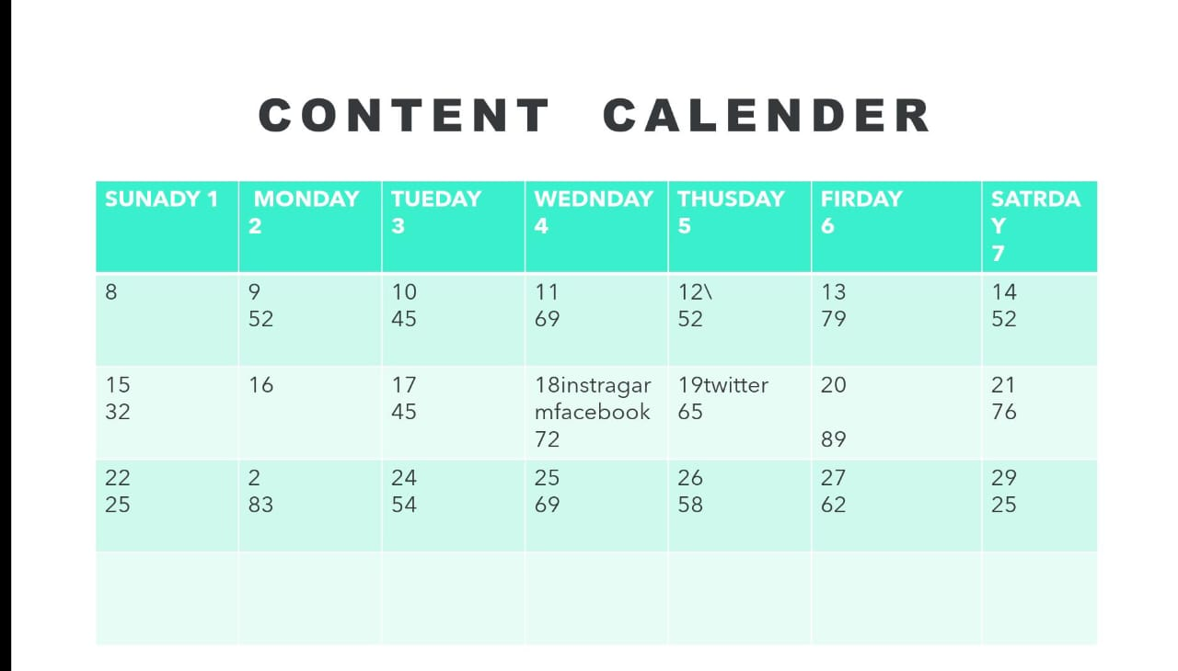
CONTENT CALENDER

Slide 16
SEO OF WIPRO
Wipro, as a prominent multinational corporation, should focus on a comprehensive SEO strategy to enhance its online visibility. This strategy should encompass meticulous keyword research, optimizing on-page elements such as meta titles and descriptions, ensuring mobile and site speed optimization, and maintaining an exceptional user experience. Backlink building from authoritative sources, local SEO for physical locations, and content quality are equally vital. Regularly monitor website performance using analytical tools, and adapt strategies based on changing search engine algorithms. For a company of Wipro's stature, international SEO, voice search optimization, and social media engagement should also be integrated into the SEO plan to maintain a strong online presence.

Slide 17
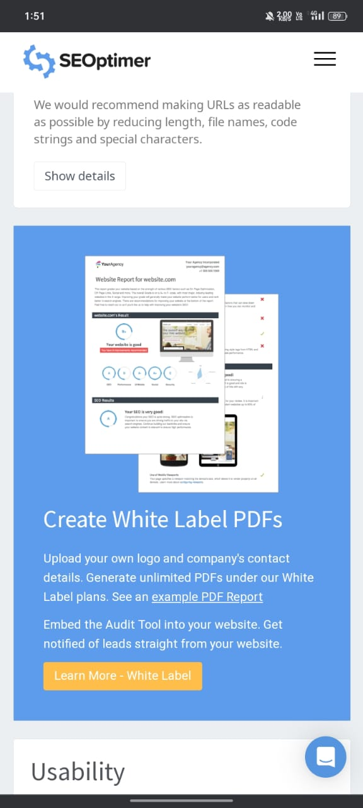
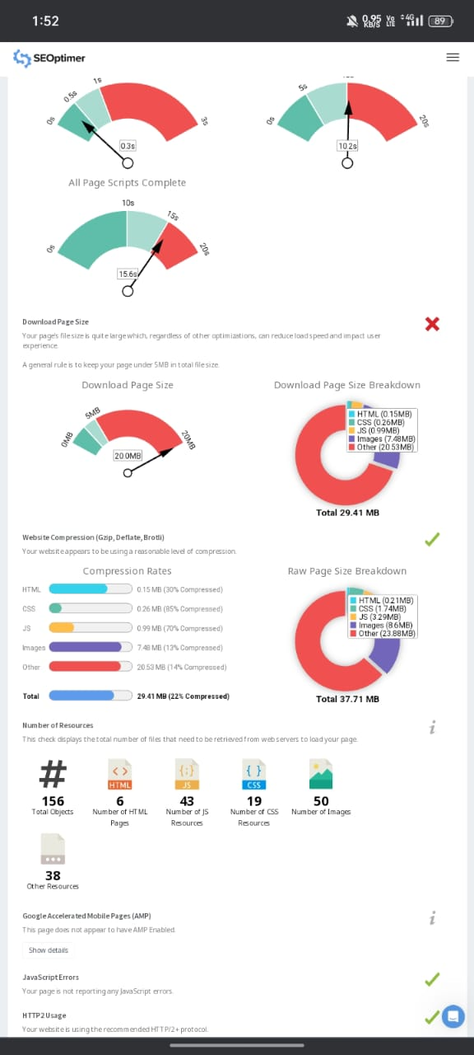
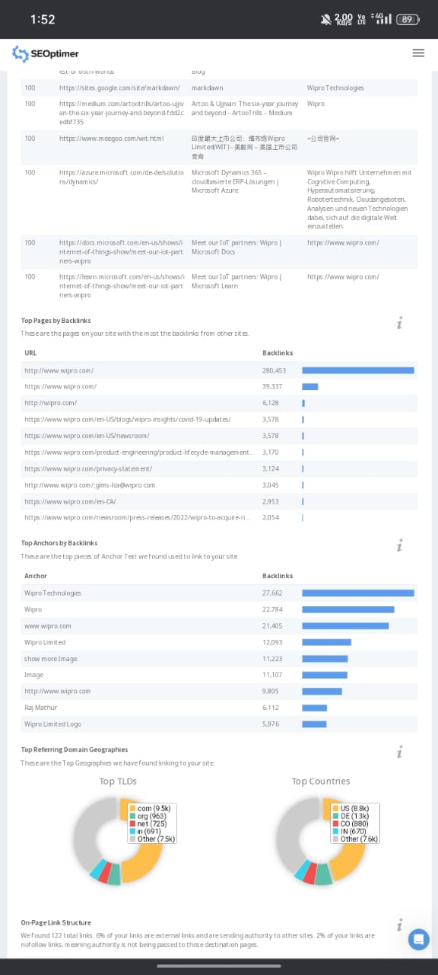

Slide 18
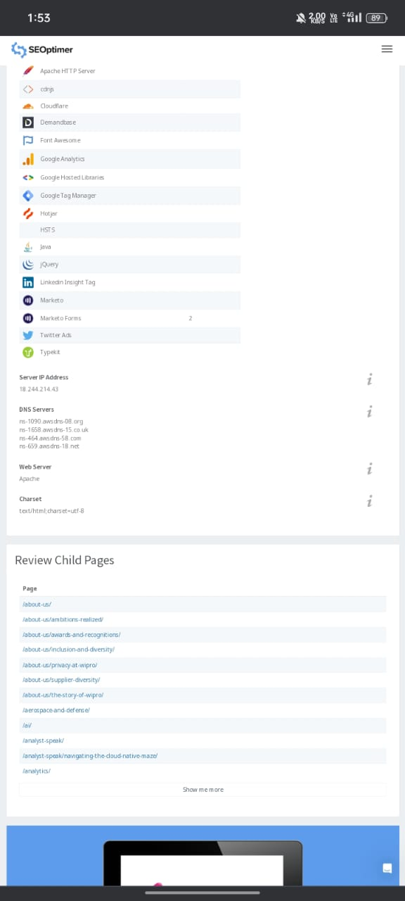
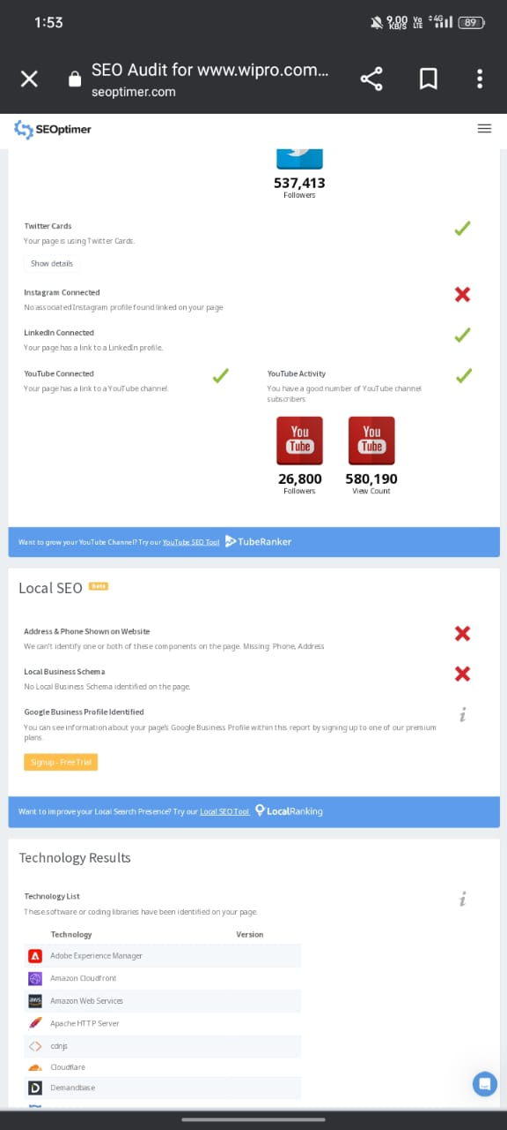
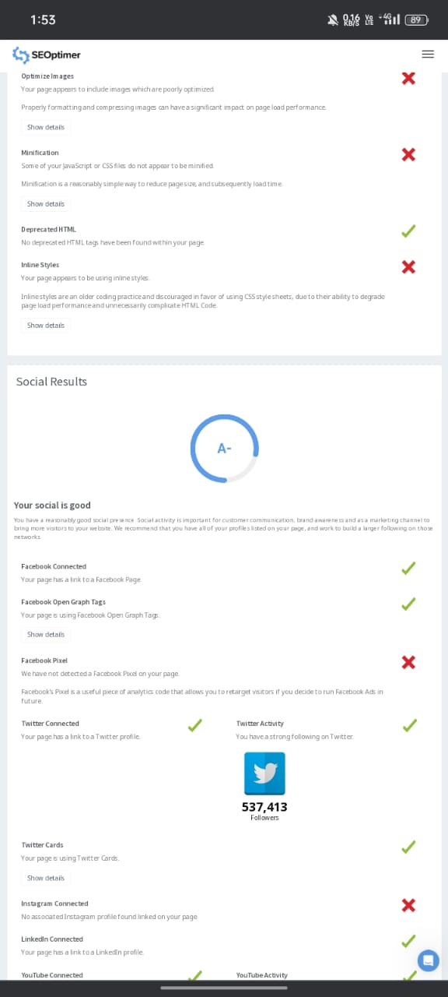

Slide 19
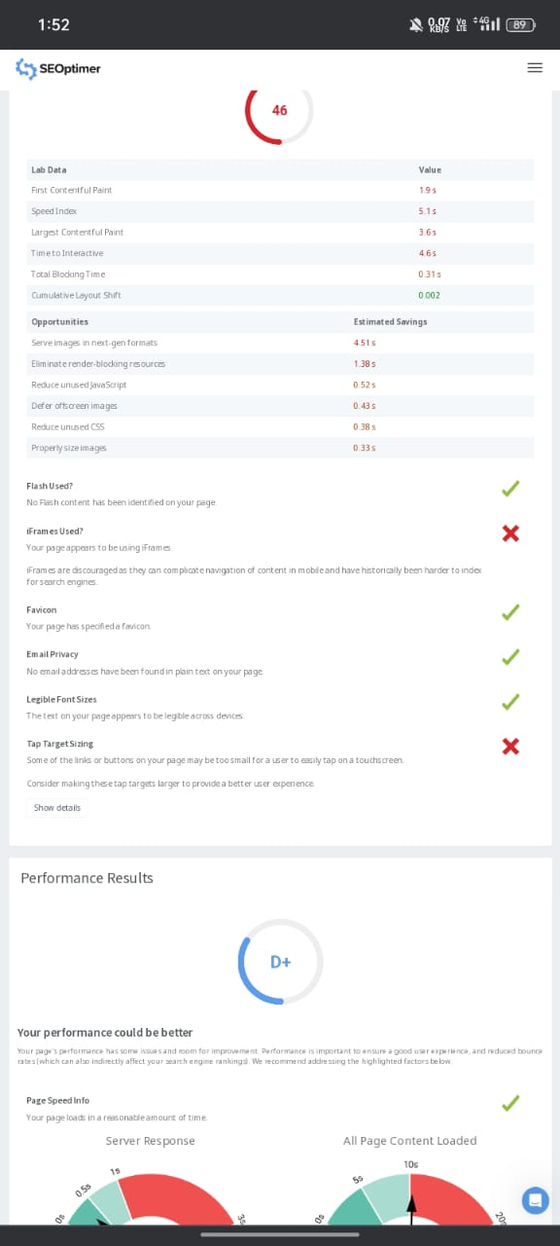
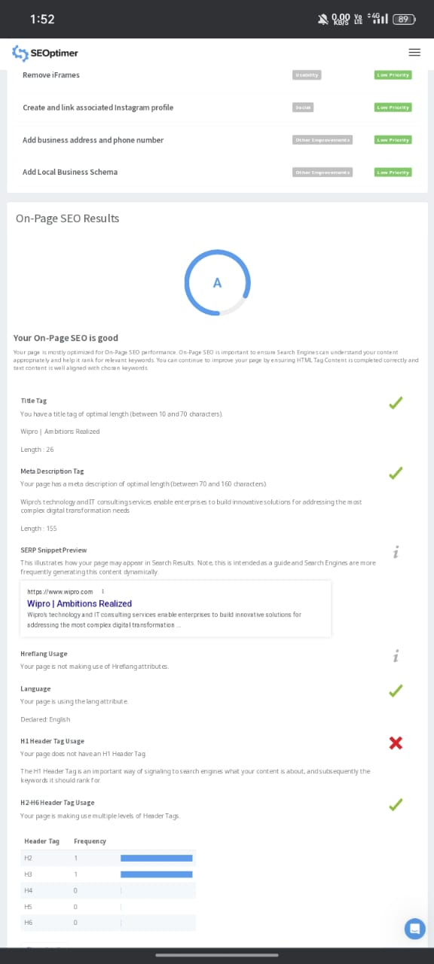
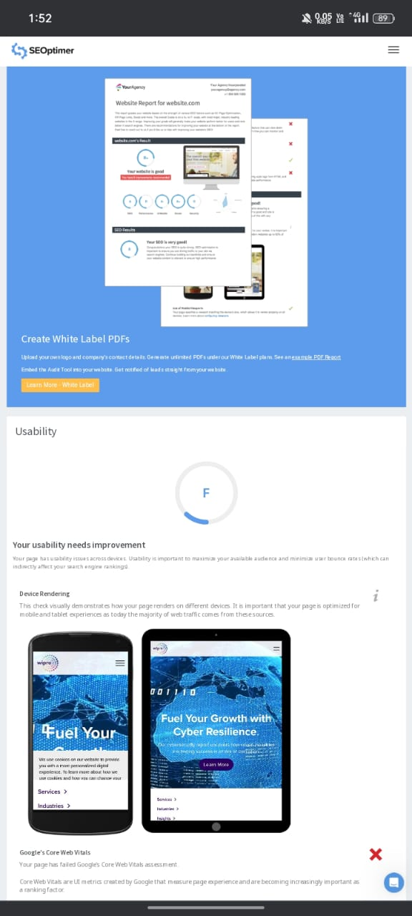

Slide 20
BRAND CURATION
Brand curation for wipro invovles managing and shaping the company ‘s image , reputation ‘ and identity. This can include
Logo and visual identity
Social media management
public Relations
Partnership’s and collaborations
CRS and Sustainability
Employee Engagement

Slide 21
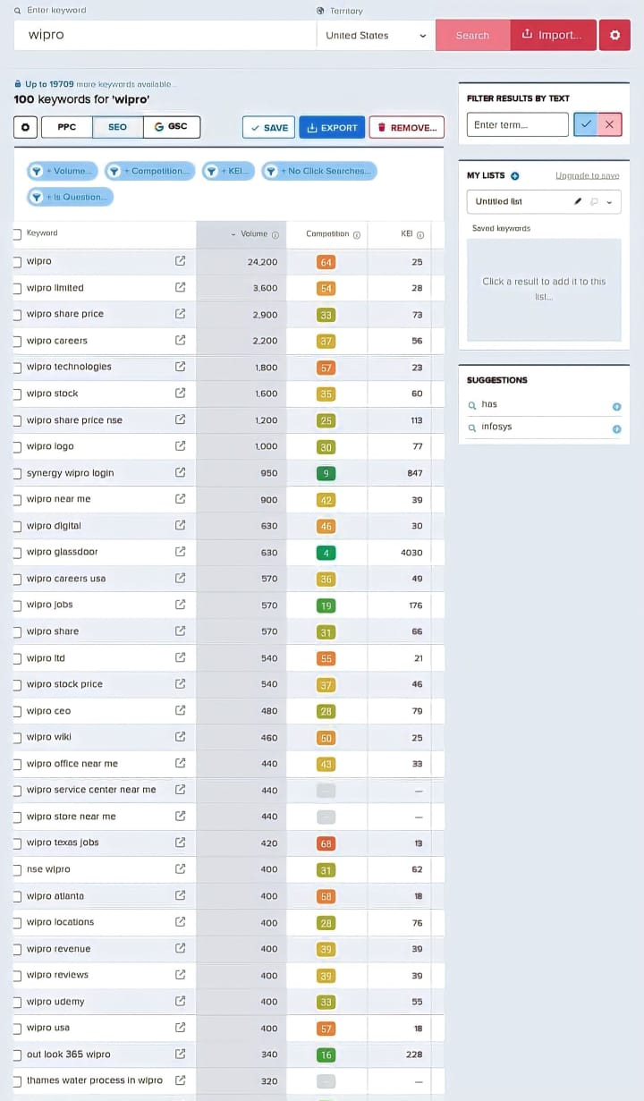
KERWORD RESEARCH

Slide 22
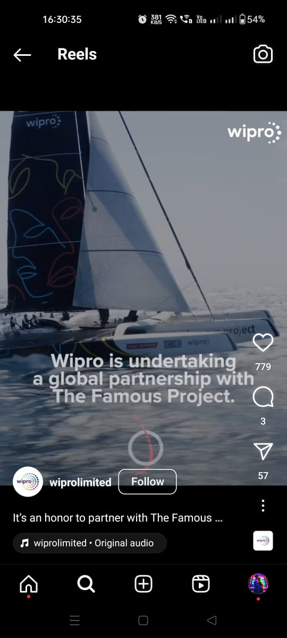
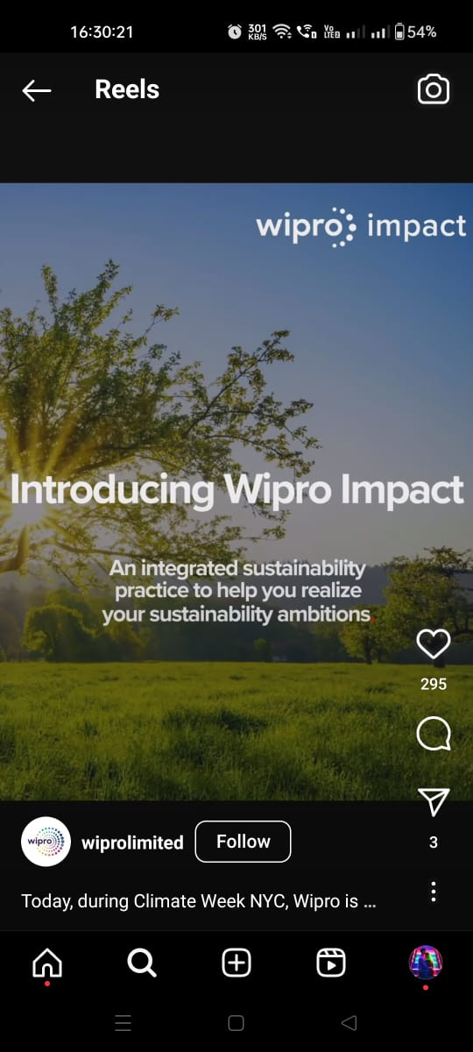
Instagram of Wipro
URL:
https://instagram.com/wiprolimited?igshid=MWZjMTM2ODFkZg==

Slide 23
THANKYOU

